Slide 1

Freedom in Christ
Gal. 5:1

Slide 2
Gal 1:6 I marvel that ye are so soon removed from him that called you into the grace of Christ unto another gospel: 7 Which is not another; but there be some that trouble you, and would pervert the gospel of Christ.

Slide 3
Gal 3:1 O foolish Galatians, who hath bewitched you, that ye should not obey the truth, before whose eyes Jesus Christ hath been evidently set forth, crucified among you?

Slide 4
John 8:36 If the Son therefore shall make you free, ye shall be free indeed.

Slide 5
THOSE IN THE CHURCH WHO WERE DETERMINED TO LEAD BELIEVERS BACK TO THE LAW, HAD TO GO.

Slide 6
3 Directives for Living Free in Christ

Slide 7

3 Directives for Living Free in Christ
Directive One: Stand your Ground!
Stand fast – to be stationary.
Psa 89:28 My mercy will I keep for him for evermore, and my covenant shall stand fast with him.

Slide 8

WE ARE TO BE FIXED IN FREEDOM!

Slide 9

3 Directives for Living Free in Christ
Directive One: Stand your Ground!
Directive Two: Settle God’s Truth!
AS A BELIEVER IN JESUS CHRIST, FREEDOM IS YOUR RIGHT.

Slide 10
3 Directives for Living Free in Christ
Directive One: Stand your Ground!
Directive Two: Settle God’s Truth!
Rom 8:12 Therefore, brethren, we are debtors, not to the flesh, to live after the flesh.

Slide 11

3 Directives for Living Free in Christ
Directive One: Stand your Ground!
Directive Two: Settle God’s Truth.
Directive Three: Solidify Your Guide.
Spirit: Emancipation.
Flesh: Incarceration.

Slide 12
3 Directives for Living Free in Christ
Directive One: Stand your Ground!
Directive Two: Settle God’s Truth.
Directive Three: Solidify Your Guide.
Rom 8:2 For the law of the Spirit of life in Christ Jesus hath made me free from the law of sin and death.

Slide 13
3 Directives for Living Free in Christ
Directive One: Stand your Ground!
Directive Two: Settle God’s Truth.
Directive Three: Solidify Your Guide.
2 Cor. 3:17 Now the Lord is that Spirit: and where the Spirit of the Lord is, there is liberty.

Slide 14
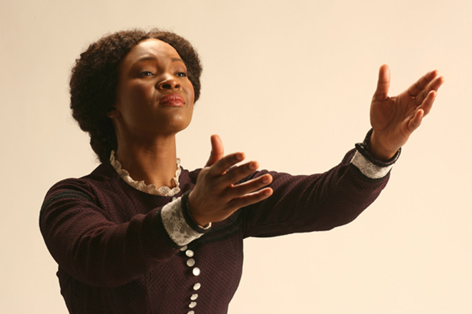
Margaret Garner
1834 - 1858
Bondage is no way to live.

